Slide 1
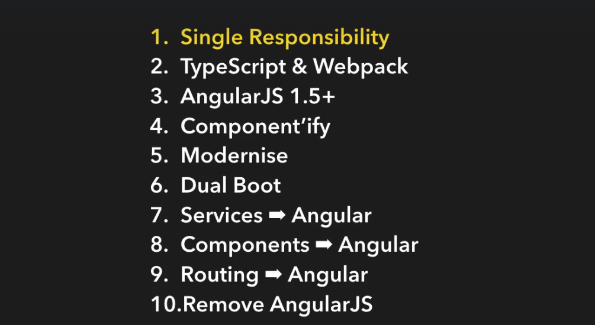

Slide 2
Step 1
一个文件一个controller/directive ….

Slide 3

Step 2
改 js => ts
Add index.ts
Change bower to npm
Npm install rimraf ts-loader typescript webpack --save-dev
Reference js in main.ts, remove from index.html
Import angular to fix angular error
check

Slide 4
Step 3
Upgrade angularjs

Slide 5
Step 4
改写 directive to component
改写 controller to component

Slide 6
Step 5
改写 service

Slide 7
Step 6
Add angular 6 reference
Add ployfills ?
Bootstrap angular

Slide 8
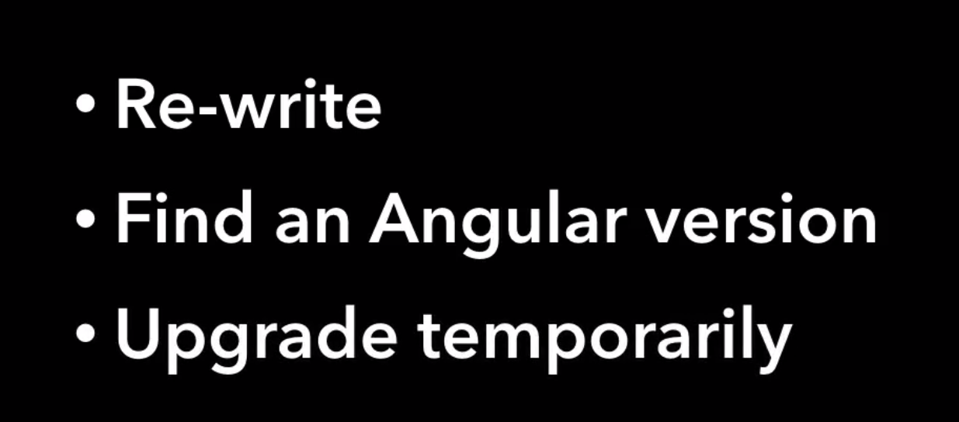
Step 7
Add HttpClient
downgradeInjectable service
Third part js tools ajs-upgraded-provier

Slide 9
Step 8 Migrate Components to Angular
Change controller to Component
@Component

Slide 10
Source
http://www.codetunnel.io/how-to-do-loading-spinners-the-angular-2/
angular-spinners https://www.npmjs.com/package/angular-spinners
Ladda https://www.npmjs.com/package/angular2-ladda
Styleguide https://github.com/johnpapa/angular-styleguide
Learn Angular 5 For FREE https://codecraft.tv/
angularjs-migration https://github.com/jawache/angularjs-migration

